Slide 1
Session objectives & key takeaways
At the end of this session you will be better able to
AI Deep Learning models
Train TensorFlow 2.0 Models on Azure ML GPU clusters.
Debug Deep Learning Models on Notebook VM.
Find best hyper parameters of the model in automated way.
Notes:
This slide is required. Do NOT delete. This should be the first slide after your Title Slide.
This slide should introduce the session by identifying how this information helps the attendee, partners and customers be more successful. Why is this content important?
This slide should call out what’s important about the session (sort of the why should we care, why is this important and how will it help our customers/partners be successful) as well as the key takeaways/objective associated with the session. Call out what attendees will be able to execute on using the information gained in this session. What will they be able to walk away from this session and execute on with their customers.
Good Objectives should be SMART (specific, measurable, achievable, realistic, time-bound). Focus on the key takeaways and why this information is important to the attendee, our partners and our customers.

Slide 2
AI
b
a
Machine learning
AI apps & agents
Knowledge mining

Slide 3
AI
b
a
Machine learning
AI apps & agents
Knowledge mining

Slide 4
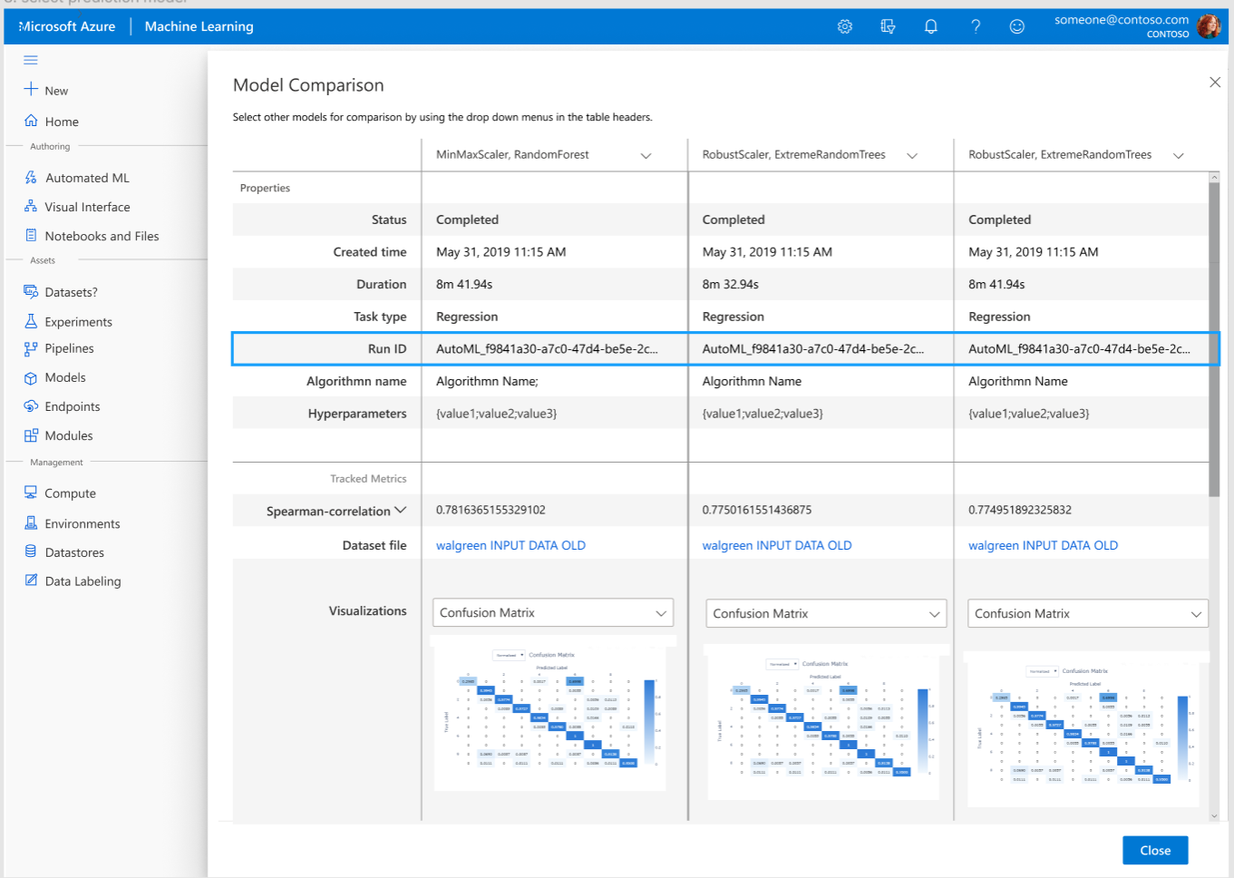
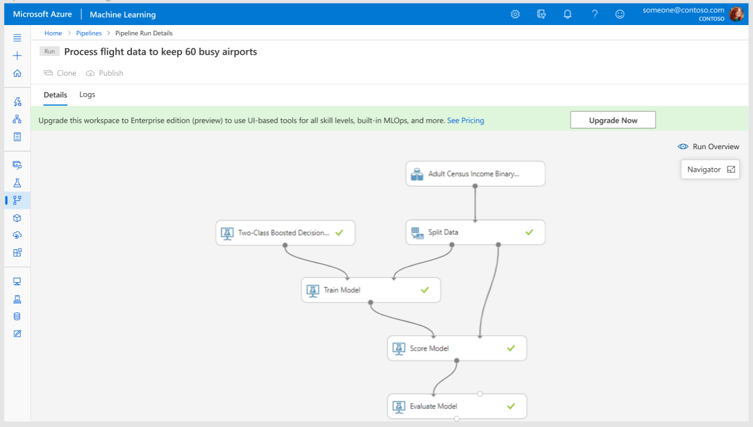
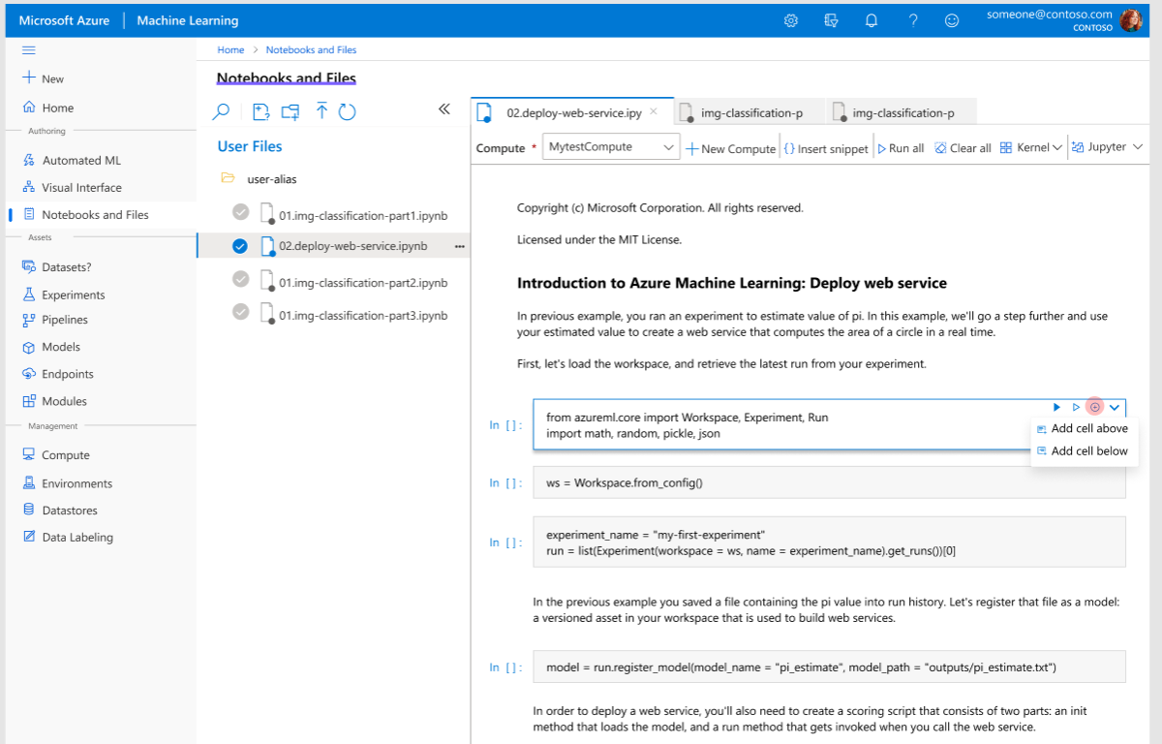
Azure Machine Learning
For all skill levels
Automated machine learning UI
Azure Machine Learning designer
Machine learning notebooks
Notes:
Rapidly build and deploy machine learning models using tools that meet your needs across skill levels, from no-code to code-first experiences. Use a visual drag-and-drop interface, a hosted notebook environment, or automated machine learning. Accelerate model development with automated feature engineering, algorithm selection, and hyperparameter sweeping.
Automated Machine Learning provides the ability to quickly determine the best models for the data that needs to be analyzed.

Slide 5



MLOps with Azure Machine Learning
Collaborate
Build app
Test app
Release app
Monitor app
App developer
using Azure DevOps
Train model
Validate model
Deploy model
Monitor model
Audit trail management and model interpretability
Data scientist using
Azure Machine Learning
Retrain model
Model reproducibility
Model validation
Model deployment
Model retraining
Notes:
Capture the data required for establishing an end to end audit trail of the ML lifecycle, including who is publishing models, why changes are being made, and when models were deployed or used in production.
Automate the end to end ML lifecycle with Azure Machine Learning and Azure DevOps to frequently update models, test new models, and continuously roll out new ML models alongside your other applications and services.
Turn your training process into a reproducible pipeline
Use ML pipelines from Azure Machine Learning to stitch together all of the steps involved in your model training process, from data preparation to feature extraction to hyperparameter tuning to model evaluation.
Package and debug models
Before deploying a model into production, it is packaged into a Docker image. In most cases, image creation happens automatically in the background during deployment. For advanced scenarios, you can manually specify the image.
Register and track ML models
Model registration allows you to store and version your models in the Azure cloud, in your workspace. The model registry makes it easy to organize and keep track of your trained models.
Monitor ML applications for operational and ML related issues - compare model inputs between training and inference, explore model-specific metrics and provide monitoring and alerts on your ML infrastructure.

Slide 6
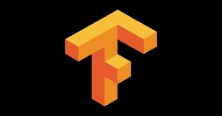


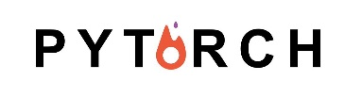
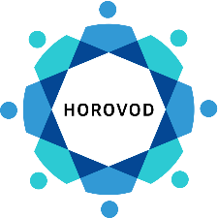
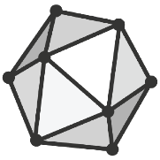

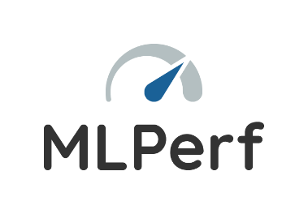


Machine Learning
Open & Interoperable
Any toolkit, any framework
13
Notes:
Balance slide – 3 pillars – why most compelling – FIX IMAGE/SLIDE
Productivity – automated ML, user GUI
E2e – ML ops,
Open plat – ONNX runtime MLFlow

Slide 7
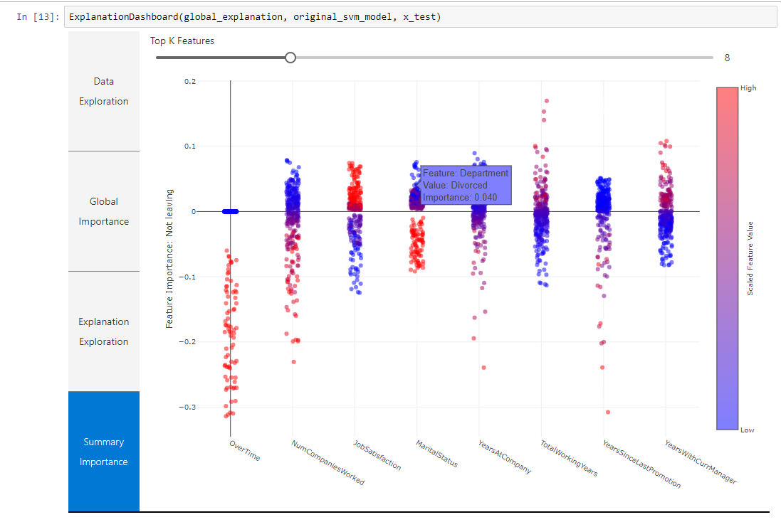
Azure Machine Learning
Trusted
Model explainability and fairness
14
Notes:
Balance slide – 3 pillars – why most compelling – FIX IMAGE/SLIDE
Productivity – automated ML, user GUI
E2e – ML ops,
Open plat – ONNX runtime MLFlow

Slide 8
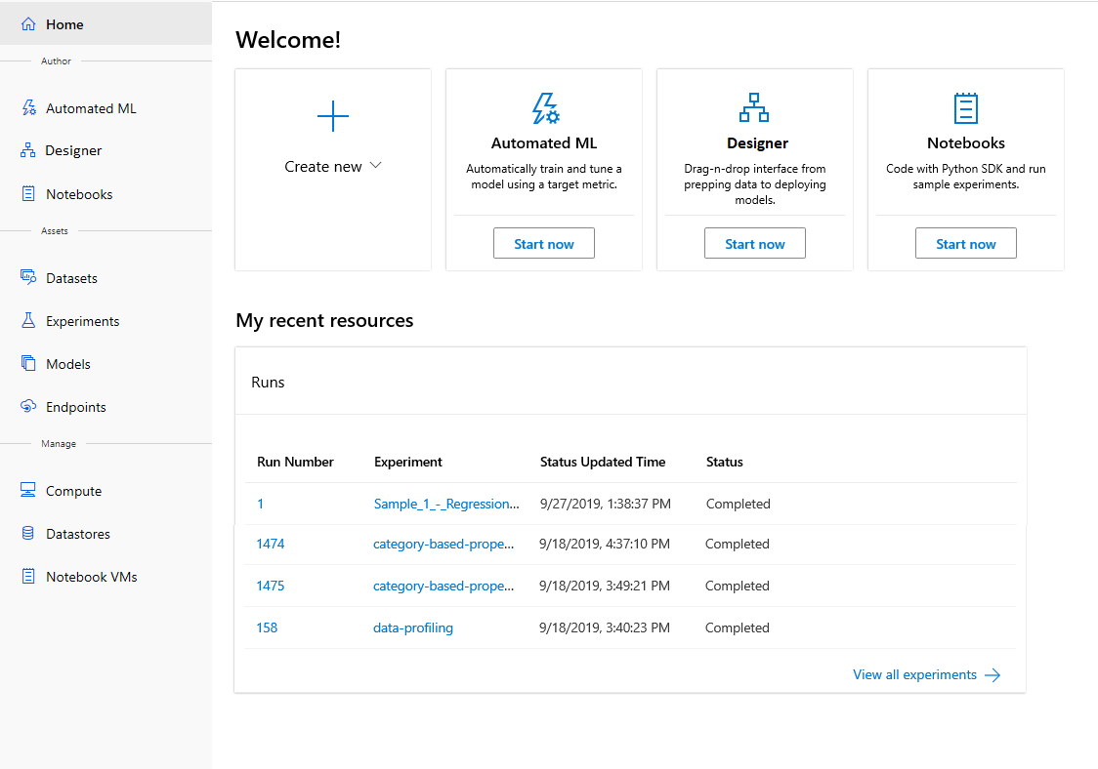
NEW CAPABILITIES
Azure Machine Learning
Enterprise edition
Unified data science experience
R support
https://azure.microsoft.com/en-us/blog/azure-machine-learning-ml-for-all-skill-levels/

Slide 9
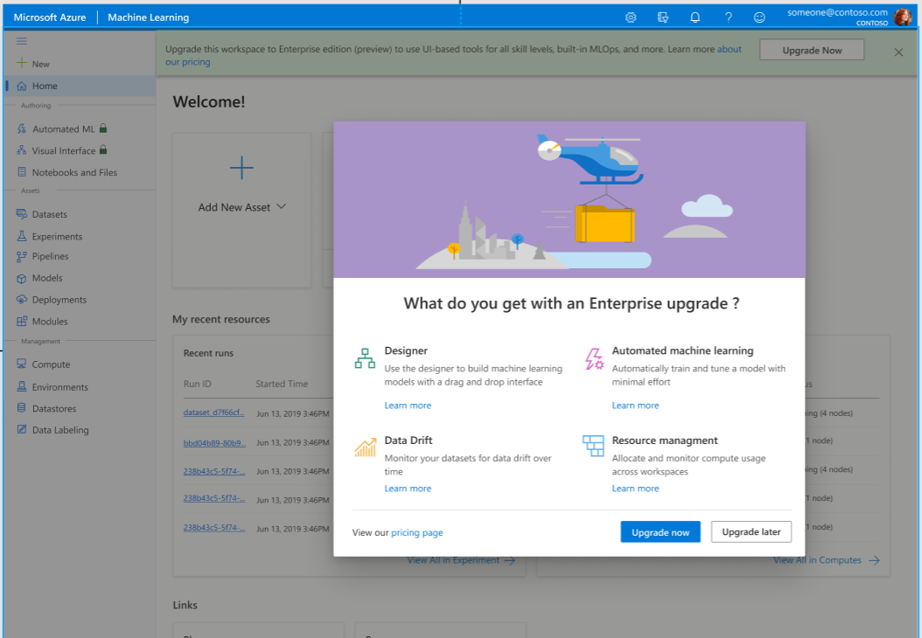
Enterprise Edition (preview)
Announcing Azure Machine Learning Enterprise edition
Contain no-code ML capabilities (AutoML and designer) as well as new AutoML DNNs, data drift UI and cross-workspace compute
Complements existing offering, which is being renamed to “Azure Machine Learning Basic
While in preview, pay only for Azure resources consumed

Slide 10
Deep Learning Terms
ANN (Artificial Neural Network):
it's a very broad term that encompasses any form of Deep Learning model. All the others you listed are some forms of ANN. ANNs can be either shallow or deep. They are called shallow when they have only one hidden layer (i.e. one layer between input and output). They are called deep when hidden layers are more than one (what people implement most of the time). This is where the expression DNN (Deep Neural Network) comes.
CNN (Convolutional Neural Network):
they are designed specifically for computer vision (they are sometimes applied elsewhere though). Their name come from convolutional layers: they are different from standard (dense) layers of canonical ANNs, and they have been invented to receive and process pixel data.
RNN (Recurrent Neural Network):
they are the "time series version" of ANNs. They are meant to process sequences of data. They are at the basis of forecast models and language models. The most common kind of recurrent layers are called LSTM (Long Short Term Memory) and GRU (Gated Recurrent Units): their cells contain small, in-scale ANNs that choose how much past information they want to let flow through the model. That's how they modeled "memory".

Slide 11
Deep Learning Workshop
Open workshop github repo and follow instructions in the readme:
https://github.com/maxluk/bert-cloud-architect-boot-camp

Slide 12
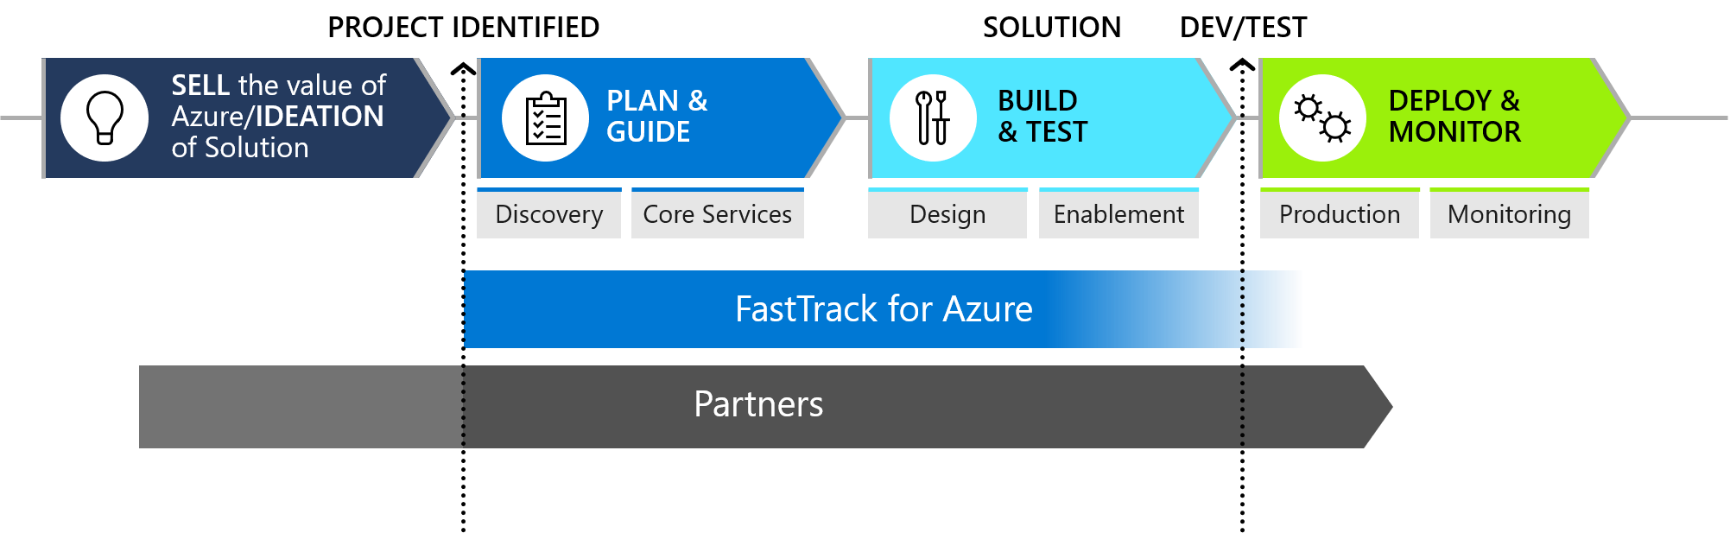
FastTrack for Azure
Best practices, advisory, guidance, and checks the viability and resilience of the architecture directly from Azure Engineering.
How it works
Partner identifies a cloud native project and nominates a customer
A FastTrack for Azure Program Manager qualifies the nomination
Assigns ongoing FastTrack resource aligned to project needs
Progress the engagement across distinct phases
Path to cloud profitability
Reducing your costs and mitigating risks for your customer’s Azure project
Access to learning and key information
Available latest in blueprints, reference architecture, product innovations
Faster time to market
Create and deploy repeatable solutions across your customers
Learn more and nominate customers’ projects at http://azure.com/ftpartners

Slide 13
Session objectives & key takeaways
At the end of this session you will be better able to
Build Deep Learning Models using Azure ML Notebooks.
Train Deep Learning Models on Azure ML GPU clusters.
Debug Deep Learning Models on Notebook VM.
Find best hyper parameters of the model in automated way.
Notes:
This slide is required. Do NOT delete. This should be the first slide after your Title Slide.
This slide should introduce the session by identifying how this information helps the attendee, partners and customers be more successful. Why is this content important?
This slide should call out what’s important about the session (sort of the why should we care, why is this important and how will it help our customers/partners be successful) as well as the key takeaways/objective associated with the session. Call out what attendees will be able to execute on using the information gained in this session. What will they be able to walk away from this session and execute on with their customers.
Good Objectives should be SMART (specific, measurable, achievable, realistic, time-bound). Focus on the key takeaways and why this information is important to the attendee, our partners and our customers.

Slide 14
Questions?

